Slide 1



superstore sales project
View in Power BI
Last data refresh:
8/19/2022 8:50:05 AM UTC
Downloaded at:
8/20/2022 5:14:58 AM UTC

Slide 2
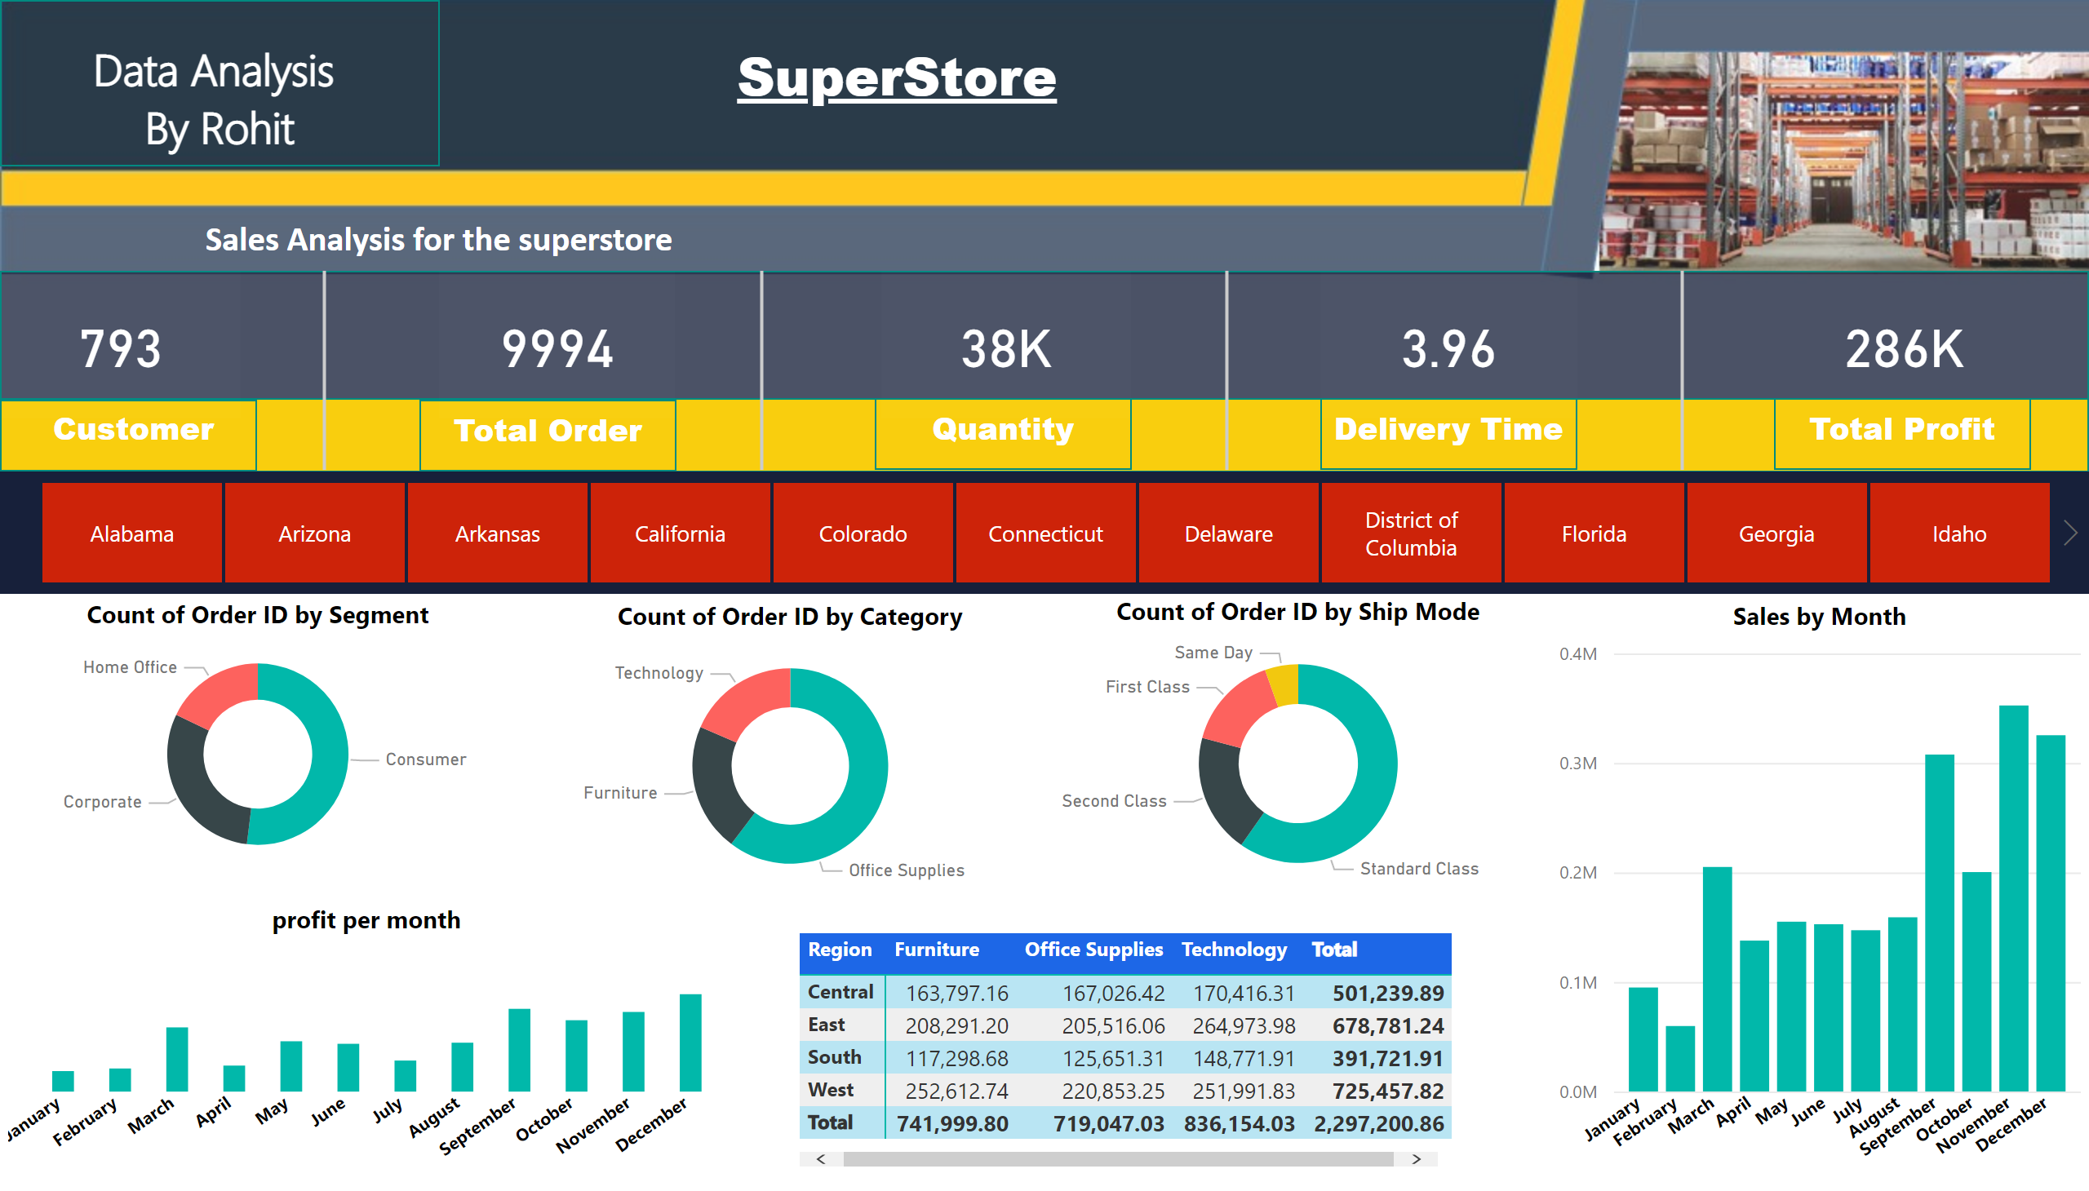
Page 1
Notes:
card
No alt text provided
card
No alt text provided
card
No alt text provided
card
No alt text provided
card
No alt text provided
shape
No alt text provided
shape
No alt text provided
textbox
No alt text provided
textbox
No alt text provided
textbox
No alt text provided
shape
No alt text provided
shape
No alt text provided
shape
No alt text provided
shape
No alt text provided
shape
No alt text provided
textbox
No alt text provided
textbox
No alt text provided
textbox
No alt text provided
textbox
No alt text provided
textbox
No alt text provided
shape
No alt text provided
shape
No alt text provided
shape
No alt text provided
shape
No alt text provided
shape
No alt text provided
slicer
No alt text provided
donutChart
No alt text provided
donutChart
No alt text provided
donutChart
No alt text provided
clusteredColumnChart
No alt text provided
profit per month
No alt text provided
pivotTable
No alt text provided

